Slide 1
Creating the Intellectual Arrogance scale
Greg Johnson
Psyc 520T

Slide 2
Construct
Intellectual arrogance: having an exaggerated or egotistic sense of one’s own intellect or knowledge.
Notes:
“I know more than your or I’m smarter than you and that makes me better than you and everyone else.”
The way I initially conceptualized intellectual arrogance was from personal experience, past interactions. Initial conceptualization was fairly idiosyncratic.
Note: theoretically this construct should be somewhat dissociable from actual smarts or knowledge. You can be intellectually arrogant and know very little; you can be a genius and humble about it. Unfortunately I couldn’t check this because my 90% of my sample didn’t remember their high school or college GPA and no one knew their IQ.

Slide 3
Background
Social/personality psychology.
Narcissism in the normal spectrum: NPI.
Arrogance in the workplace.
Workplace behaviors: WARS.
André Green’s theory of narcissism.
Cerebral vs. somatic.
Synthesis into the Intellectual Arrogance Scale
Importance: academia, hiring process
Notes:
Went into the literature to see if I could find a similar construct or something related that would help me delimit intellectual arrogance.
Closest I could find was: Andre Green.
Then: personality field (narcissism is a normative personality trait), not the clinical field (narcissism is pathological). I looked at the empirical work which is mostly factor analysis studies of the NPI. A lot of disagreement: anywhere from 2 to 7 factors pulled out. A common factor for several of the studies was arrogance or something like it.
Also: IO psychology – all about nice workplace dynamics. Of course arrogance is a huge issue. There is a scale that operationalizes arrogance as certain workplace behaviors.
Used NPI (items loaded onto arrogance or arrogance-like factors) and WARS to help construct the IA scale.
In academia where everyone is very smart, there’s bound to be arrogance attached to it. Understanding IA will allow us to address it, avoid people high in it, to reduce friction and butting of heads. Perhaps it can be integrated into the hiring process I would think the chance of a faking good response set during a job interview is high.

Slide 4
Scale construction I
Overview:
Primary Purpose
Content Domain
Response Format
Initial Pool
Preliminary Item Tryouts
Calibrate and Revise
Establish Construct Validity
Notes:
First 4 I’ll cover now. 5 & 6 are the FlexMIRT calibration and the Wald test. 7 is at the very end, where I correlate IA scale theta scores and the sum scores of other theoretically related and unrelated measures.

Slide 5
Scale construction ii
The Purpose of the IA Scale
“To accurately estimate the level of intellectual arrogance a person has in order to inform hiring, placement, cost-benefits, etc.”
Notes:
Not much to say.

Slide 6
Scale construction iii
Defining the Content Domain of IA
Specific construct
Attitudes & behaviors
Directed towards self & towards others
Notes:
Thought of it as a fairly atomic construct, low in the grand hierarchy of personality constructs. Subsumed under narcissism and arrogance. Not any expected sub constructs.
Attitudes and past behaviors.
Just wanted to make sure I wasn’t undersampling some cruicial part of the content domain.

Slide 7
Scale construction iV
Picking Response Format
Likert scale
“Strongly disagree”
“Disagree”
“Neutral”
“Agree”
“Strongly agree”
More sensitive.
Notes:
I wanted to work with a polytomous model – they seemed more fun to work with than the dichotomous models.
Likert scale is more sensitive. And if it turns out five categories isn’t more sensitive, some categories are crap, I can collapse them. Whereas you can’t expand from dichotomous response format to polytomous.

Slide 8
Scale construction V
Constructing the Initial Pool of Items
Most items were modified from the NPI or the WARS.
The rest were based on my personal observations.
30 items → 20 items
Notes:
Like I said earlier items were created using the NPI, the WARS, and my personal experience. I started with 30 and whittled it down to 20 based on bad wording, redundancy, etc.

Slide 9
Data collection
Survey was created in Google Documents and administered through Amazon Mechanical Turk.
Three batches at 10 cents per completion.
Qualification: HIT approval rate 95%, 1000 HIT approvals
80 questions
9 minutes on average
Survey data was coded in SPSS and then analyzed in CEFA and FlexMIRT.
Uneven response distributions forced collapsing of categories (<11% of responses).
Notes:
About 9 questions a minute.
Looked at frequencies of category responses for each item. Very very few people strongly disagreed, so that category was collapsed for every single item. And for a select few items I collapsed disagree into neutral or strongly agree into agree. So items were either 4- or 3-categories.

Slide 10
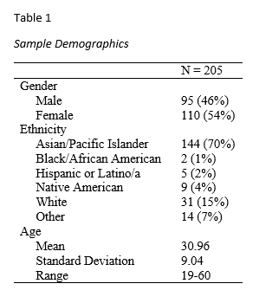
Data collection II
mTurk Sample:
Notes:
Pretty nice split between genders. A lot of Asians for some reason. The age distribution was a little skewed but just because there was a cluster of older adults. Unfortunately I didn’t get any objective measures of intelligence

Slide 11
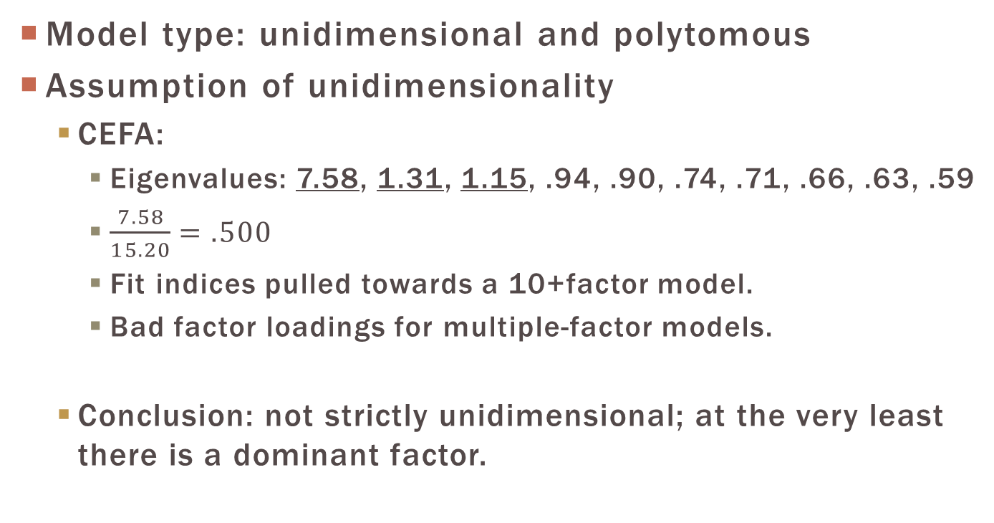
Scale analysis
Model type: unidimensional and polytomous
Assumption of unidimensionality
CEFA:
Eigenvalues: 7.58, 1.31, 1.15, .94, .90, .74, .71, .66, .63, .59
$\frac{7.58}{15.20}=.500$
Fit indices pulled towards a 10+factor model.
Bad factor loadings for multiple-factor models.
Conclusion: not strictly unidimensional; at the very least there is a dominant factor.
Notes:
I went with a unidimensional, polytomous model, polytomous because of my response format and unidimensional because I don’t have large enough n and I don’t know how to use it.
I factor-analyzed the covariance matrix of the IA scale in CEFA.
First 10 eigenvalues. Those underlined fulfill the Kaiser criterion.
Dividing the firs eigenvalue by the sum of the first ten yielded 50% so the scale was very much in the gray zone of unidimensionality in terms of being able to run IRT.
Fit indices headed towards a seriously overfactored solution.
And trying to rotate and find factor solutions for multiple-factor models was disastrous. A ton of cross-loadings, some factors had no loading above .3. Awful.
I bit the bullet and assumed unidimensionality. At least that there was a dominant factor.

Slide 12
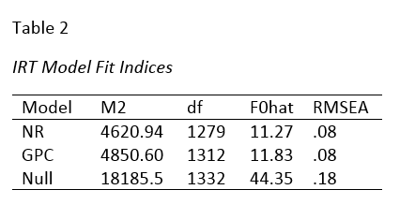
Scale analysis II
Model: Nominal Response Model
CBDs will vary within items.
“Neutral” may not stay in order.
Fit indices
Wald test would allow application of different models to different items.
Notes:
Most of my items were very strongly phrased, very overtly about intellectual arrogance so I thought maybe CBDs for, say, strongly agree vs. agree would be a lot steeper than those for strongly disagree and disagree.
I thought that Safe to be wary of neutral, especially with a personality construct like this.
looked at FlexMIRT fit indices. M2 and Fhat decreased, indicating better fit for NRM. And RMSEA stayed the same – it did not penalize the NRM for estimating more parameters and losing parsimony.

Slide 13
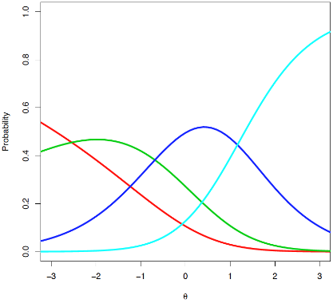
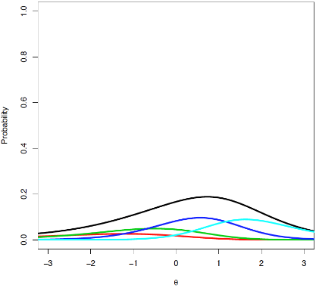
Scale analysis: Item 1
“Being smart is something that you’re born with.”
Cat: SD & D, N, A, SA
CBDs: 0.37, 0.88, 1.17
Notes:
Very weak slope for strongly disagree vs. disagree.
Not so great for disagree vs. neutral.
Neutral vs. agree is okay.
This is a trend for a lot of my items: weak CBDs at the lower end, steep CBDs at the higher end. So the CBDs seem to vary significantly within items but some category collapsing may be in order.
However, poor information, so scrap!

Slide 14
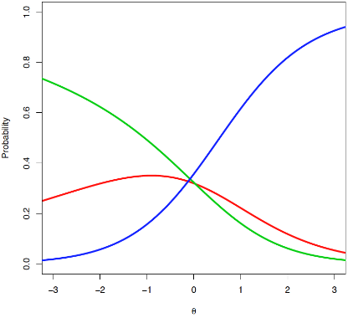
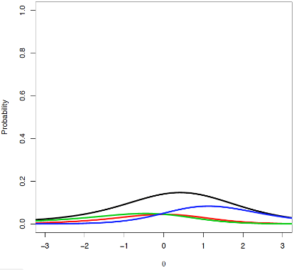
Scale analysis: Item 2
“I enjoy being around those not as smart as I am.”
Cat: SD & D, N, A & SA
CBDs: -0.33, 1.24
Notes:
Big thing to notice besides the flat-lining item information, I had a negative CBD for disagree vs. neutral. Their order switched so good thing I used the NRM. But the CBD is small so this item is a candidate for becoming dichotomous. However I scrapped it for low information.

Slide 15
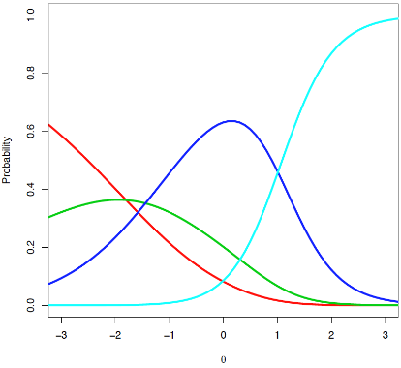
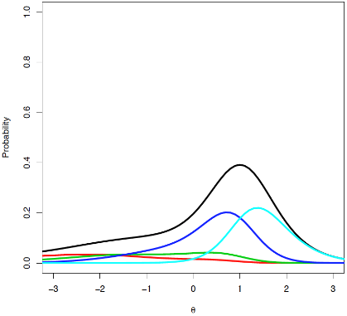
Scale analysis: Item 3
“I like to be complimented about my knowledge of something.”
Cat: SD & D, N, A, SA
CBDs: 0.50, 0.79, 1.98
Notes:
Here’s the first item that isn’t pure crap. Lower end CBDs are still terrible so the information curves for strongly disagree and disagree are flat. However there is a pretty decent CBD between neutral and agree which gives the item info a peak over a theta of 1.
Candidate for dichotomization.

Slide 16
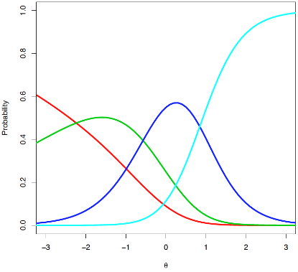
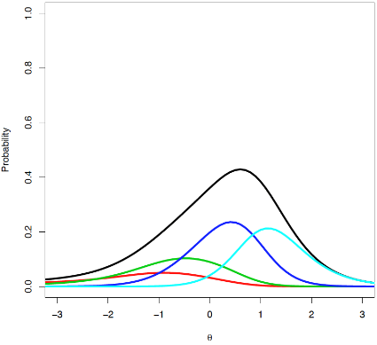
Scale analysis: Item 4
“I often see others at work and think, ‘I can do a better job than they can.’”
Cat: SD & D, N, A, SA
CBDs: 0.46, 1.38, 1.87
Notes:
Continuing the trend, the lower CBD is crap. But the other two are pretty good, between disagree and neutral, and neutral and agree. Get some nice information here.

Slide 17
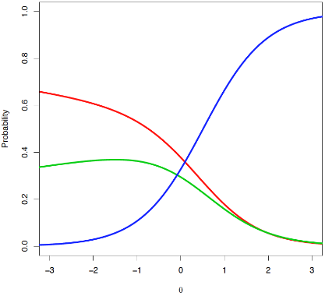
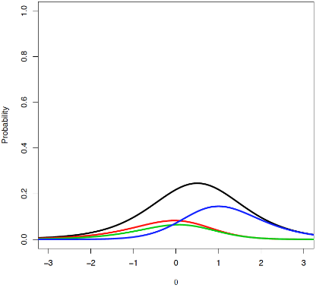
Scale analysis: Item 5
“Hanging out with some people is boring or awkward because they’re not as knowledgeable as I am.”
Cat: SD & D, N, A & SA
CBDs: 0.13, 1.33
Notes:
So disagree is crap here. This is a candidate for dichotomization.

Slide 18
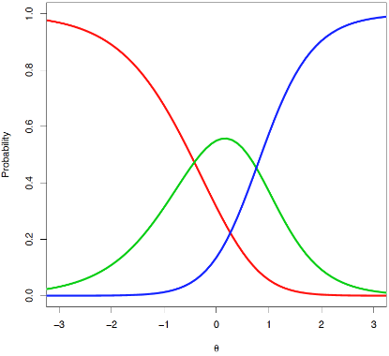
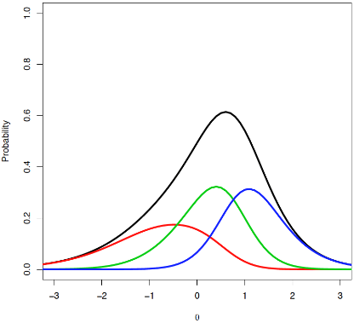
Scale analysis: Item 6
“I enjoy being around those as smart as I am.”
Cat: SD & D & N, A, SA
CBDs: 1.33, 1.84
Notes:
This is a pretty item. First CBD isn’t bad but the second one is nice and steep, giving some nice information to the agree categories. Looks like it may be a candidate for the GPC.

Slide 19
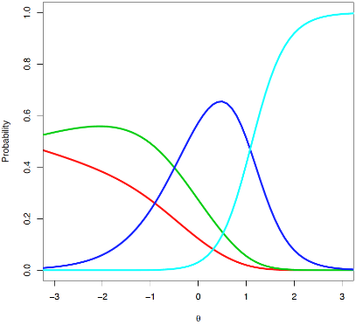
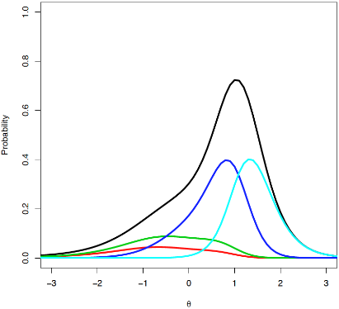
Scale analysis: Item 7
“I have a reputation around my friends of being ‘the smart one’ or the one that knows almost everything.”
Cat: SD & D, N, A, SA
CBDs: 0.21, 1.49, 2.69
Notes:
Same trend of crap CBD to quality CBD. Same trend in increasing information for the categories.

Slide 20
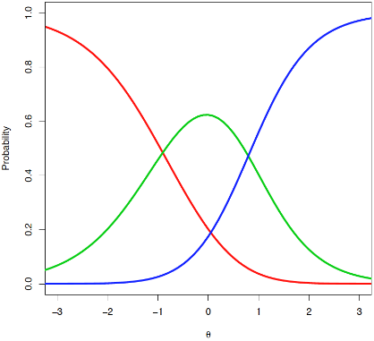
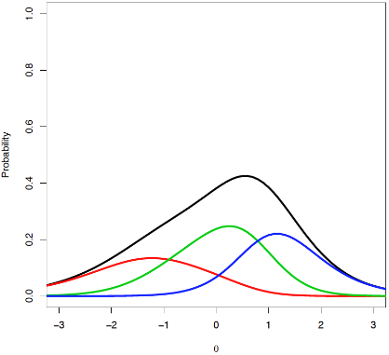
Scale analysis: Item 8
“I like to tell people about the new things that I’ve learned.”
Cat: SD & D & N, A, SA
CBDs: 1.25, 1.60
Notes:
Another pretty item. Total item info doesn’t peak much but it’s got nice spread. CBs look to be located at theta of 1 and of -1. Maybe GPC?

Slide 21
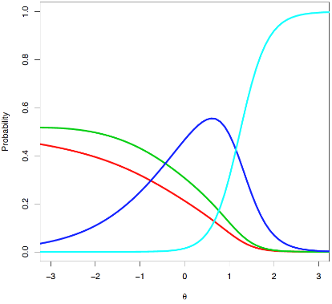
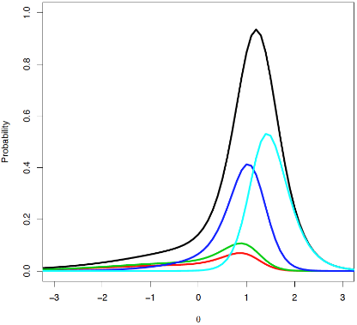
Scale analysis: Item 9
“I am rarely wrong when I get in disagreements of fact with friends.”
Cat: SD & D, N, A, SA
CBDs: 0.07, 0.97, 3.04
Notes:
This item has some serious info thanks to the CBD of 3.04. Disagrees are crap again.

Slide 22
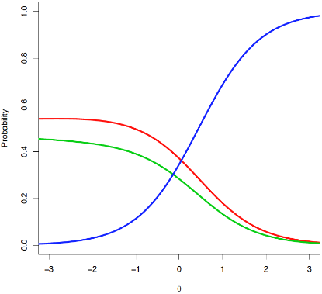
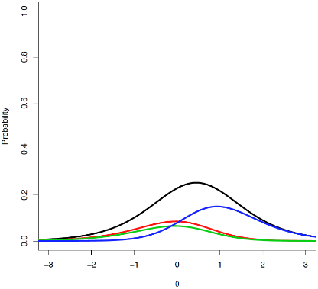
Scale analysis: Item 10
“I dislike doing menial tasks because they do not intellectually challenge me.”
Cat: SD & D, N, A & SA
CBDs: -0.03, 1.44
Notes:
Another reversal. That can be handled through dichotomization.

Slide 23
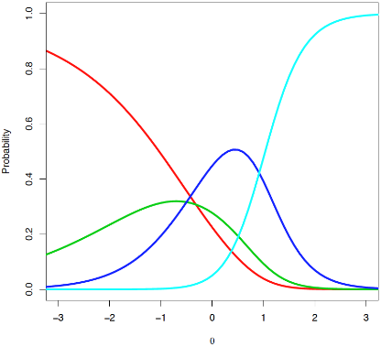
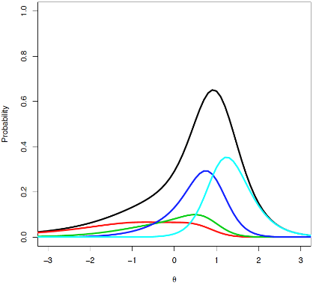
Scale analysis: Item 11
“I like to show off my knowledge and smarts.”
Cat: SD & D, N, A, SA
CBDs: 0.66, 0.96, 2.39
Notes:
Neutral is crap here so disagree and neutral provide very little info.

Slide 24
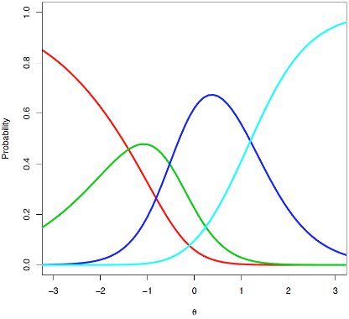
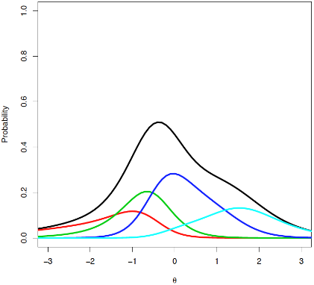
Scale analysis: Item 12
“I think my intellect is one of the best things about me.”
Cat: SD & D, N, A, SA
CBDs: 0.95, 1.94, 1.57
Notes:
Finally I get an item with some info below a theta of 0. This is the only item in which I didn’t collapse categories.

Slide 25
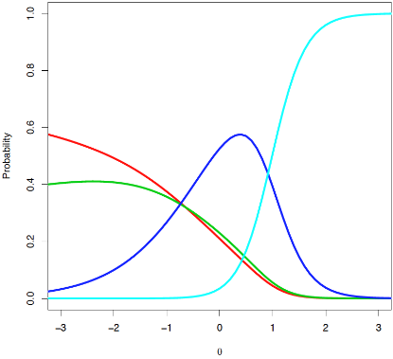
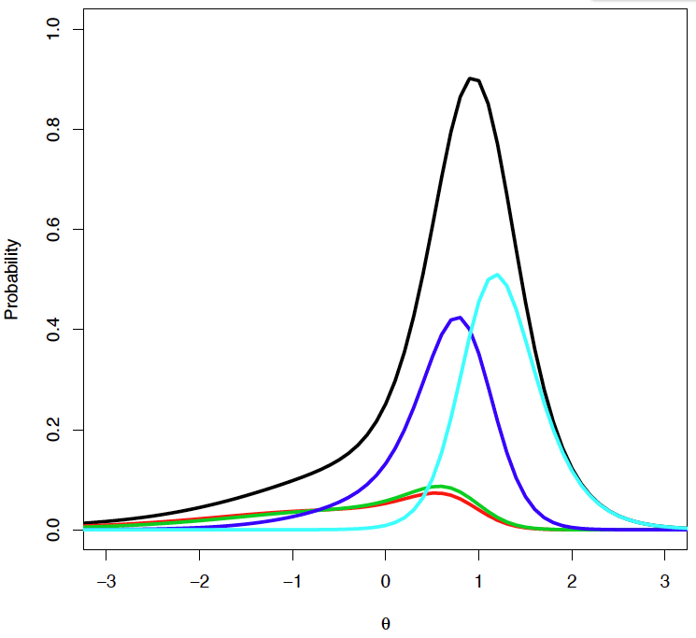
Scale analysis: Item 13
“I tend to correct the mistakes of others even if the mistakes are small.”
Cat: SD & D, N, A, SA
CBDs: 0.14, 1.12, 2.97
Notes:
More category collapsing in order. Terrible and low CBD.

Slide 26
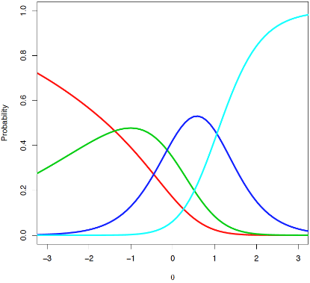
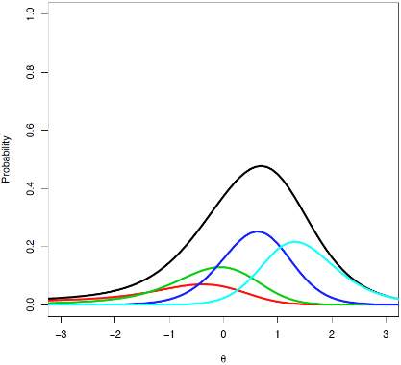
Scale analysis: Item 14
“I have no problem making decisions for others if I’m smarter and more knowledgeable than they are.”
Cat: SD & D, N, A, SA
CBDs: 0.52, 1.51, 1.82
Notes:
More category collapse. More info at 1.

Slide 27
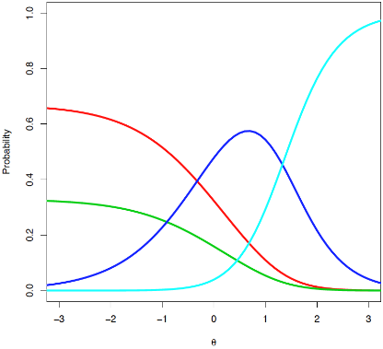
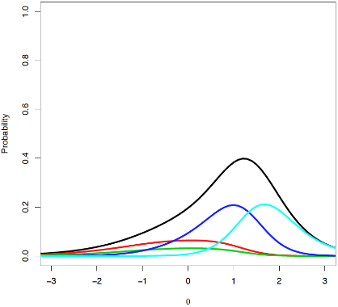
Scale analysis: Item 15
“Helpful feedback rarely comes from those less knowledgeable than me.”
Cat: SD & D, N, A, SA
CBDs: 0.00, 1.21, 1.88
Notes:
I got a CBD of 0 between disagree and neutral. Their intersection point is technically infinite. So definite collapsing of categories.

Slide 28
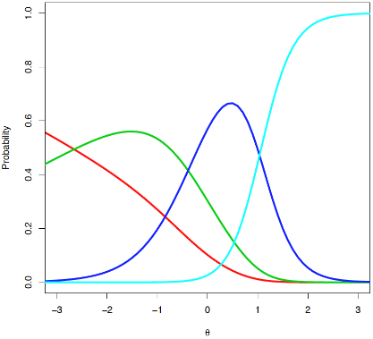
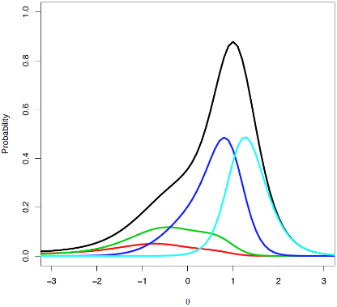
Scale analysis: Item 16
“People always seem to recognize my intellect/smarts.”
Cat: SD & D, N, A, SA
CBDs: 0.41, 1.63, 2.97
Notes:
Nice item info here. Disagrees aren’t performing too well.

Slide 29
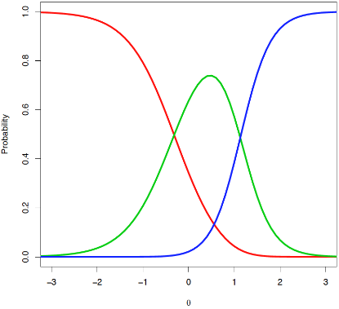
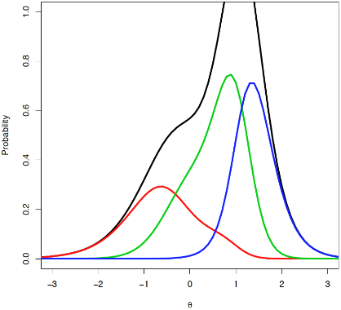
Scale analysis: Item 17
“People learn a great deal from me.”
Cat: SD & D & N, A, SA
CBDs: 1.96, 3.00
Notes:
Some great info here. But when I performed the Wald test later the CBDs weren’t significantly different which means the standard errors were pretty high with parameter estimation here. Maybe that’s why info is off the charts.

Slide 30
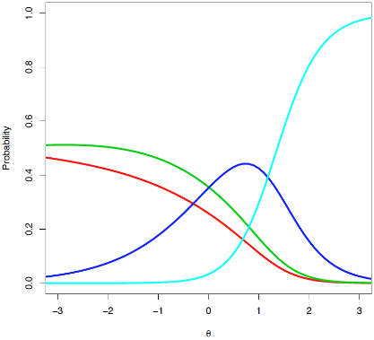
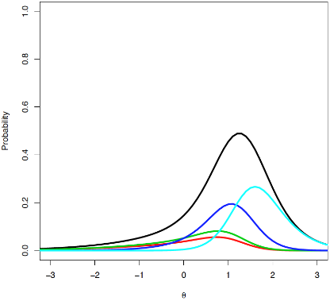
Scale analysis: Item 18
“If I make a difficult decision requiring complex reasoning and the person affected wouldn’t understand my reasoning, it’s okay to keep him or her uninformed.”
Cat: SD & D, N, A, SA
CBDs: 0.07, 0.95, 2.01
Notes:
Disagrees are crap. 3-cat is in order.

Slide 31
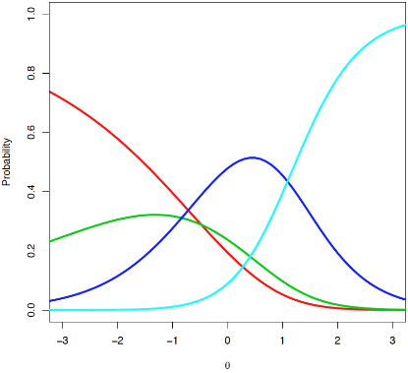
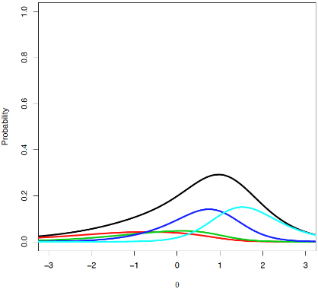
Scale analysis: Item 19
“Sometimes I find myself learning new things not because I’m truly interested but because it makes me more knowledgeable than others.”
Cat: SD & D, N, A, SA
CBDs: 0.42, 0.84, 1.54
Notes:
Adequate item centered over 1 again.

Slide 32
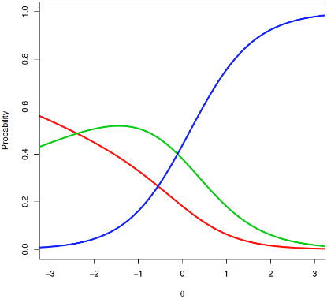
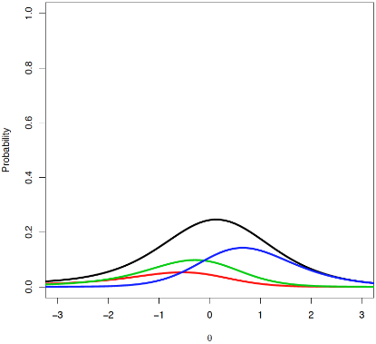
Scale analysis: Item 20
“I am rarely wrong when I get in disagreements of fact with family.”
Cat: SD & D, N, A & SA
CBDs: 0.31, 1.29
Notes:
Looks like it should be dichotomized.

Slide 33
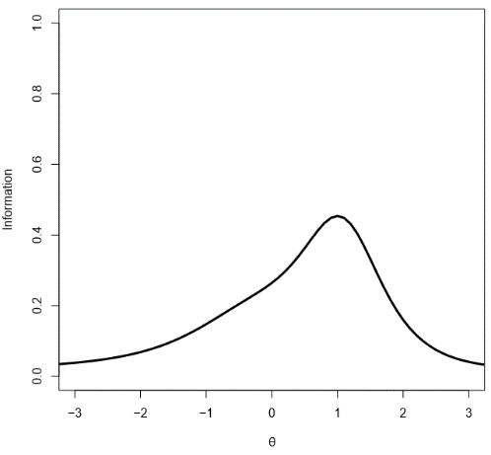
Scale analysis: Test info
Notes:
So peak of information at a theta of 1. Gradual slope off to the left to lower theta scores and a sharp drop off beyond 1.5 theta. So the IA scale is telling us the most about people who are high on the IA continuum.

Slide 34
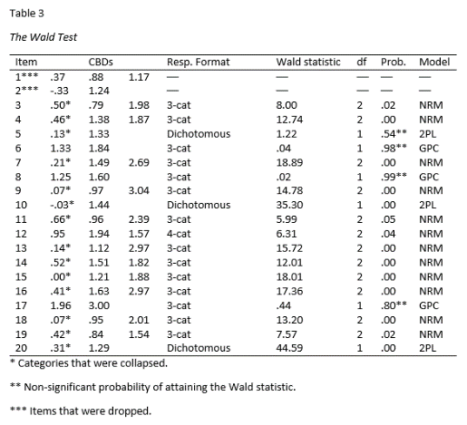
Scale revision: Wald test
Notes:
Busy but there are three important things to notice:
Three asterisks: items that were dropped due to poor information.
One asterisk were CBDs that I destroyed by collapsing the categories that form them.
Two asterisks were non-significant probabilties of obtaining the Wald statistic. So the CBD’s didn’t significantly vary so I shouldn’t let them vary and eat away at parsimony by estimating more parameters than necessary.

Slide 35
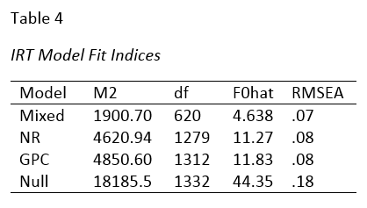
Scale revision: Current version
Models: Nominal Response Model, Generalized Partial Credit Model, 2 Parameter Logistic Model
Fit Indices:
Notes:
Fit indices indicate better fit for the mixed model. The RMSEA actually decreases to .07.

Slide 36
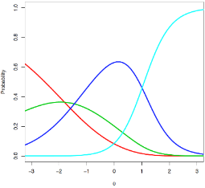
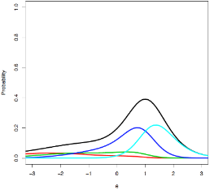
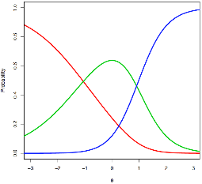
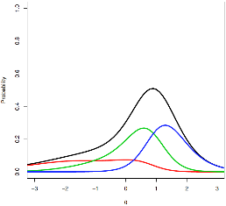
Scale revision: item 3
“I like to be complimented about my knowledge of something”
NR Model
Notes:
Now a 2cat item. Disagree/neutral is still crap here. I should dichotomize here.

Slide 37




Scale revision: item 4
I often see others at work and think, ‘I can do a better job than they can.’”
NR Model
Notes:
Now that the two lower categories have combined and that low CBD is gone, this may be a candidate for GPC in the next round of Wald revision. Getting slightly more info now because the disagree/neutral is giving more info.

Slide 38




Scale revision: item 5
“Hanging out with some people is boring or awkward because they’re not as knowledgeable as I am.”
2PL Model
Notes:
Slightly more information from dichotomization.

Slide 39




Scale revision: item 6
“I enjoy being around those as smart as I am.”
GPC Model
Notes:
I actually lost information by constraining the CBD parameters. That was the cost of increased parsimony.

Slide 40




Scale revision: item 7
“I have a reputation around my friends of being ‘the smart one’ or the one that knows almost everything”
NR Model
Notes:
Not a big change in item info. Candidate for GPC?

Slide 41




Scale revision: item 8
“I like to tell people about the new things that I’ve learned.”
GPC Model
Notes:
GPC model killed the information, so this looks like it should be scrapped.

Slide 42




Scale revision: item 9
“I am rarely wrong when I get in disagreements of fact with friends.”
NR Model
Notes:
Lost information here. Looks like a candidate for GPC.

Slide 43




Scale revision: item 10
“I dislike doing menial tasks because they do not intellectually challenge me.”
2PL Model
Notes:
Increase in info.

Slide 44




Scale revision: item 11
“I like to show off my knowledge and smarts.”
NR Model
Notes:
Slight increase in info. Maybe GPC again.

Slide 45
Scale revision: item 12
“I think my intellect is one of the best things about me.”
NR Model
Notes:
Not changed.

Slide 46



Scale revision: item 13
“I tend to correct the mistakes of others even if the mistakes are small.”
NR Model
Notes:
Increase in information now that the lower categories were combined.

Slide 47




Scale revision: item 14
“I have no problem making decisions for others if I’m smarter and more knowledgeable than they are.”
NR Model
Notes:
Candidate for GPC. Slight increase in information.

Slide 48




Scale revision: item 15
“Helpful feedback rarely comes from those less knowledgeable than me.”
NR Model
Notes:
Very little change here. GPC now maybe.

Slide 49




Scale revision: item 16
“People always seem to recognize my intellect/smarts.”
NR Model
Notes:
GPC model. The trend seems to be that when the lowest CBD is eliminated by collapsing the two categories that form it, the two remaining CBDs are quite alike.

Slide 50




Scale revision: item 17
“People learn a great deal from me.”
GPC Model
Notes:
A little dip in information. There isn’t much discrimination now at this point.

Slide 51




Scale revision: item 18
“If I make a difficult decision requiring complex reasoning and the person affected wouldn’t understand my reasoning, it’s okay to keep him or her uninformed.”
NR Model
Notes:
Slight increase in information.

Slide 52




Scale revision: item 19
“Sometimes I find myself learning new things not because I’m truly interested but because it makes me more knowledgeable than others.”
NR Model
Notes:
Candidate for GPC?

Slide 53




Scale revision: item 20
“I am rarely wrong when I get in disagreements of fact with family.”
2PL Model
Notes:
Increased information here.

Slide 54

Scale revision: test information
Notes:
So the overall shape is the same but there is more full over a theta of 0. The peak itself is actually higher, past .5.

Slide 55

Convergent/discriminant validity
Additional scales/measures administered on mTurk:
Rosenberg self-esteem scale (RSES)
Narcissistic Personality Inventory – 16 Items (NPI-16)
Need for Cognition Scale (NCS)
Satisfaction with Life Scale (SWLS)
Notes:
Four other measures were administered on the mTurk survey.
Self-esteem has been found to be correlated with high but unstable self-esteem so I expected a positive correlation with the RSES.
IA is supposed to subsumed under narcissism so I expected a positive correlation with the NPI.
I thought IA would be unrelated to need for cognition (need to challenge yourself intellectually).
I thought IA would be unrelated to subjective well-being but it was significantly, positively correlated. Post-hoc explanation?

Slide 56
Conclusions/implications
For people at the extremes of the IA continuum, the IA Scale has little information.
Most information for those at Θ = 1.
Not a big deal considering the purpose.
Response format was inadequate
Very few people strongly disagreed with many of the items.
A lot of subpar category functioning
Notes:
Most information for those at theta of 1 but this is okay because the purpose of the test is to identify those who are on the high end of the continuum so that they can be dealt with accordingly in IO psych contexts.
Few people strongly disagreed (2%)/ and very little only disagreed. My format was ultimately inappropriate. Too many choices. Most of my items ended up being 3-cat items.
A lot of subpar category functioning resulting in shallow CBDs and low information. I had to collapse categories and sometimes resort to dichotomous items to actually get some information out of them.

Slide 57
Limitations
Weak theoretical background for construct.
Is not strictly unidimensional.
Sample quality?
RMSEA indicates mediocre fit.
Testlets weren’t created for items with local dependence.
Notes:
Sample quality: just in how well they read the questions and understood. If they actually put the time into thinking about each item and accurately reported their belief/behavior instead of blowing through it.
RMSEA mediocre fit: perhaps DIF is at play or another round of Wald revision will decrease the RMSEA further.

